Slide 1
Kidney Transplant: Exploring Living Donation
Laurie Shore, LCSW
Independent Living Donor Advocate/Social Worker
Tampa General Hospital Kidney Transplant Program
November 20, 2014

Slide 2
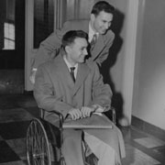
First Living Donor Transplant
1954
  Dr. Joseph Murray
  Richard and Ronald Herrick
Donor: “…here I was, 23 yrs old, young and healthy, and they were going to cut me open and take out one of my organs. It was shocking even to consider the idea. I felt a real conflict of emotions. Of course I wanted to help my brother, but the only operation I’d ever had before was an appendectomy, and I hadn’t much liked that.”
                Murray, JE. Surgery of the Soul, 2001

Slide 3
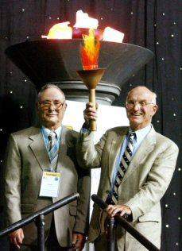
First Living Donor and Surgeon
TRANSPLANT SURGEON AND FIRST KIDNEY DONOR AT U.S. TRANSPLANT GAMES:
            “In July 2004, the National Kidney Foundation conducted its eighth biennial Olympic-style U.S. Transplant Games, this time in Minneapolis-St Paul. Dr. Joseph Murray (right) and Ronald Herrick.”
            Ronald Herrick died 2010, age 79
          www.donatelifeny.org/uploaded.../interview_joseph_murray.pdf

Slide 4
Advantages to Living Donation
Living donor kidneys last longer
Living donor transplants happen quickly
The surgery can be timed conveniently for the donor
Transplants happen when the recipient is most healthy
Can reduce the length of hospitalization
Receiving a living donor may increase life expectancy

Slide 5
Advantages to Living Donation
Better genetic match lessens risk of rejection
Reduces the risk of health problems due to long term dialysis
Potential donors are tested ahead of time to find most compatible
Living donor kidneys last longer!

Slide 6
LIVING KIDNEY DONATION
Graft Survival (transplanted kidney)
SRTR DATA, 2014
National Average

Slide 7
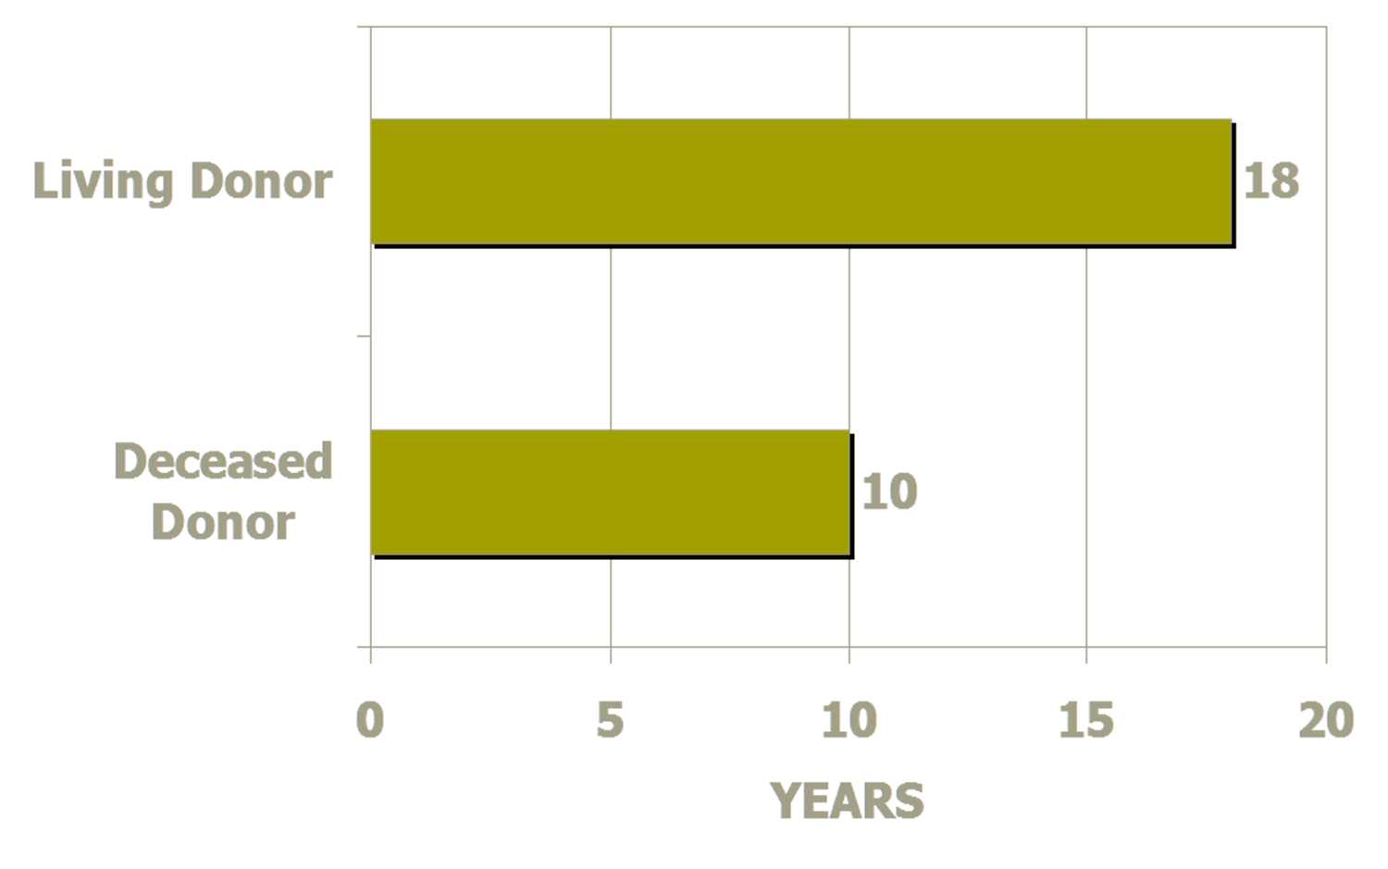

LIVING KIDNEY DONATION

Slide 8
Who Can Be a Living Donor?
Sibling
Spouse
Parents
Other Relatives
Co-Worker
Friend
Church/Temple Member
Neighbor
Non-compatible donor [paired exchange]
Altruistic Donor- 6 month wait policy (varies by Transplant Center)

Slide 9
Who Cannot Be a Living Donor?
*Varies by Transplant Center*
  Anyone under age 21
  Diabetes
  High Blood Pressure
  Fibromyalgia
  Auto-Immune Disorders
  Chronic Pain
  Heart Problems
  Other Medical Issues

Slide 10
Living Donation Process
Transplant Center process may vary:
  Evaluation is usually completed in 3-5 days
  Living donor surgery is usually done laparoscopically
  Hospitalization for living donor is usually 2-3 days

Slide 11
Medical Evaluation of the Living Donor
Goal of the medical evaluation:
  Assess Immunologic compatibility
  Assess general health and surgical risk of the donor
  Determine diseases present that may be transmitted
  Assess anatomy and function of the kidneys
              OPTN Policy 12.3.4

Slide 12
Living Donor Evaluation
What Makes a Donor Incompatible?
Donor Incompatibility:
  Having a different blood type than the recipient
  Having a positive crossmatch with the recipient
  Size discrepancy between donor and recipient
  Age discrepancy between donor and recipient

Slide 13
Alternatives to Incompatibility
Paired Kidney Exchange:
  Paired exchange provides all the advantages of living donation
  The donor receives care by the Tampa General Transplant Team
  The donor’s kidney will be shipped to another transplant center, and a kidney will be shipped to Tampa General

Slide 14
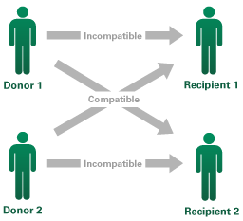
Paired Exchange Program
How It Works What happens when you find someone willing to donate a kidney to you – but it isn’t a good match? Not too long ago, that would mean the search would need to continue until a suitable match was found. There is, however, an emerging strategy for overcoming this hurdle. It’s called Paired Kidney Donation. In its simplest form, it involves two donor-recipient pairs who exchange donors (assuming each is a match for the other). It does not matter if they are a man or woman, just a good match for the candidate. In general it would look like this:

Slide 15
LIVING KIDNEY DONATION
National Kidney Registry (NKR)
PAIRED KIDNEY EXCHANGE
Altruistic Donor
Tampa Recipient
Tampa Donor
UCLA recipient
UCLA donor
Emory Recipient
Emory Donor
Next Lucky Recipient

Slide 16
Blood Type
If your blood type is: | You can donate to these blood types:
TYPE O | TYPE O, A, B, AB
TYPE A | TYPE A, AB
TYPE B | TYPE B, AB
TYPE AB | TYPE AB

Slide 17
Long Term Risks of Donation
Medical:
  High blood pressure
  Proteinuria
  Hernia
  Reduced kidney function
Psychological:
  Depression
  Feelings of regret, resentment, anger
  Body image issues-scarring

Slide 18
Independent Living Donor Advocate (ILDA) and Living Donor (LD) SW Evaluation
Psychosocial Evaluation:
  Assess the psychosocial risks
  Identify financial risks
  Advocate for the potential donor
  Capacity for informed consent

Slide 19
Post Donation Support
Support System:
  Living arrangements
    Remain local for 2 weeks
  Caregiving assistance:
    No lifting more than 10 lbs. for 6 weeks
  Transportation:
    No driving 2 weeks-10 days

Slide 20
Substance Use History
Tobacco
  May require smoking cessation
Marijuana
  May require abstinence
Alcohol
  May require AA
Other substances
  Not a candidate if recent use
Incarcerations

Slide 21
Mental Health History
Depression/coping
    Risk post donation
    Suicidal ideation (at any time)
Anxiety/panic attacks
    Psychiatric clearance
Abuse/victimization/trauma
Body image issues-scarring
Family history of mental health issues

Slide 22
Employment Status
Occupation/Employment:
  Level of education
  Current occupation
  Employer Support:
    Maintain employment post donation
    Length of employment
      4-6 weeks recovery

Slide 23
Insurance Status and Risks
Insurance:
  Health Insurance:
    Higher premiums
    Health problems not covered by recipients insurance
      Lifetime follow up
      Non donation related disease findings
  Life Insurance:
    Inability to change or increase policy
Notes:
For Recipient. The potential donor’s insurance most likely won’t be need, my insurances covers 100%. I’m running a fundraiser to pay for Donors stay in Hotel, food, travel, etc while doing testing.

Slide 24
Living Donor Protection Act of 2014
H.R. 5263:
  Introduced in House: 7/30/2014
  Referred to the Subcommittee on Health: 8/1/2014
    “…prohibition on denial of coverage or charging higher premiums of life insurance, disability insurance or long-term care insurance”
    Bruce Skyler, CEO, NKF

Slide 25
Identify Financial Risk
Personal Expenses:
  Travel, housing, child care
    National Living Donor Assistance Fund, other organizations (limited)
  Potential loss of employment/lost wages
  Negative impact obtaining , maintaining, or affording health, disability and life insurance
  Life-long follow-up at donor’s expense
    6 months, 1 year, 2 year follow up covered
                OPTN Policy 14.3.A.i

Slide 26
Capacity for Informed Consent
Understanding of information provided:
  Evaluation process
  Surgical process
  Follow up responsibilities
Awareness of options available:
  Deceased donor
  Alternate LD
  Dialysis

Slide 27
Informed Consent
Reasonable decision making:
  Right to opt out at any time
  Free for coercion
  Understanding of financial risks
  Donor evaluation is confidential
  “Disclosure that is a federal crime for any person to knowingly acquire, obtain or otherwise transfer any human organ for valuable consideration.”
OPTN Policy 14.0

Slide 28
Advocate for the Living Donor
Protect the rights of the potential donor:
  Donor’s welfare is primary
  Respecting decisions of the donor
  Transplant programs grievance process
  Decline if risk for poor psychosocial outcomes
  Genuine motivation
    No secondary gain, ambivalence, or coercion
    No family or external pressures

